Slide 1
Wiring FRC
Electrical System

Slide 2
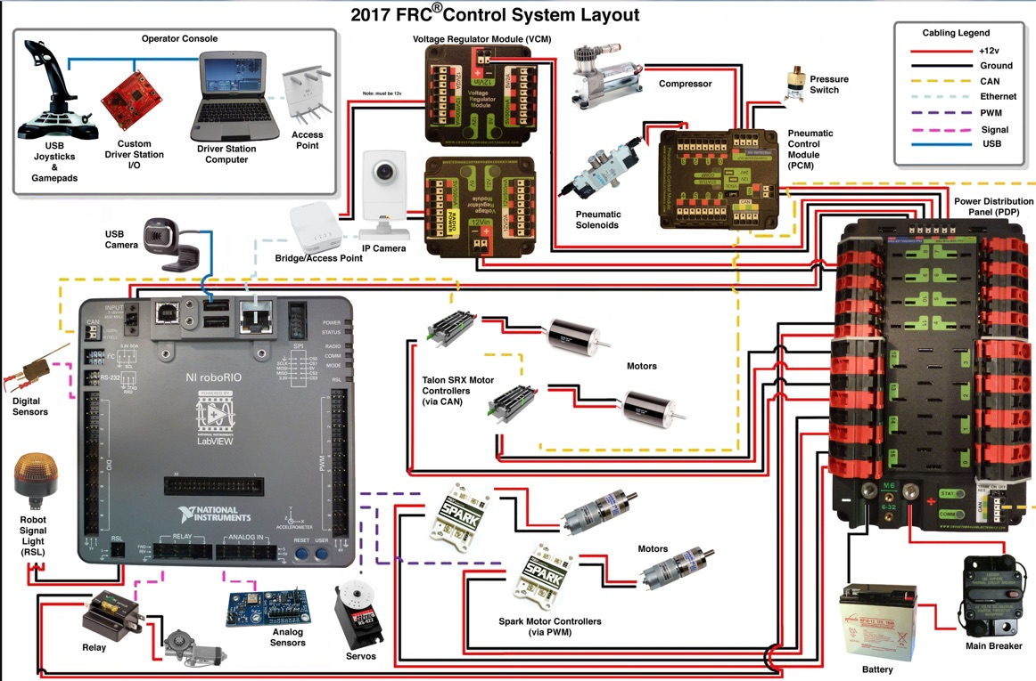
Beautiful Picture
Video for later

Slide 3

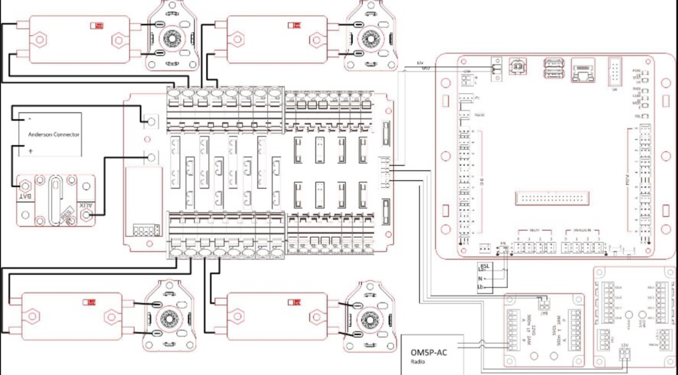
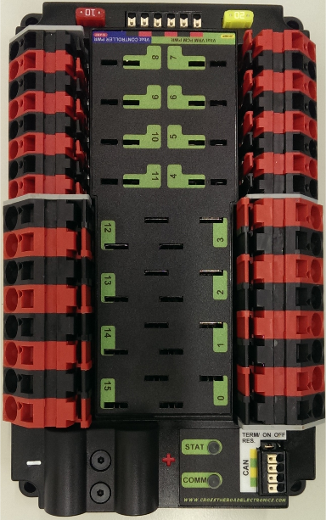
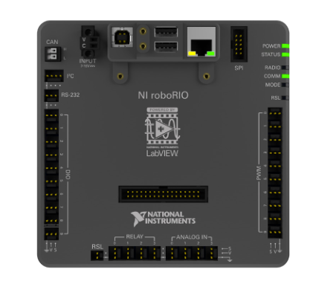
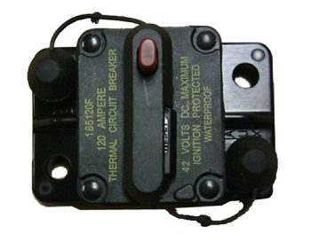
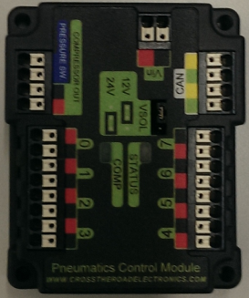
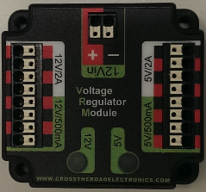
Benchtop
What do you notice about the effect on power as you increase current (I)?
Power loss is often observed as heat

Slide 4
Wiring FRC Control System
https://wpilib.screenstepslive.com/s/currentCS/m/cs_hardware/l/144971-wiring-the-frc-control-system
https://mililanirobotics.gitbooks.io/frc-electrical-bible/content/PDP/pdp.html

Slide 5
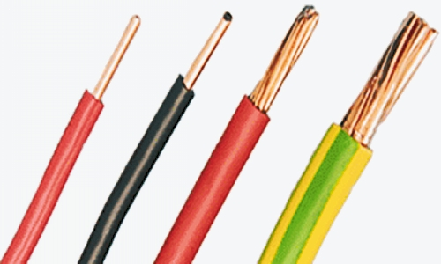
Power Wire
We use insulated copper wire (Cu). The insulation protects the wire and also protects the user. (R60)
All Main Power Wires should be either Red or Black.
Red is for “positive”, “+”, “12V”
Black is for “negative, “-”, “12V return”, “common”

Slide 6
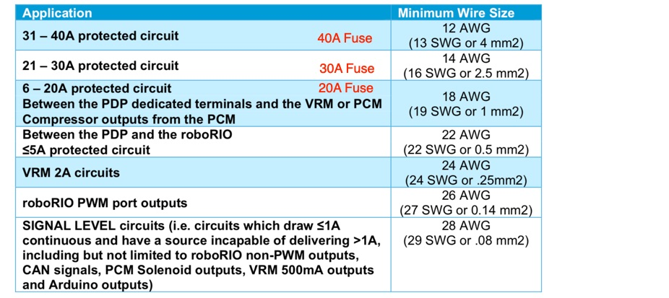
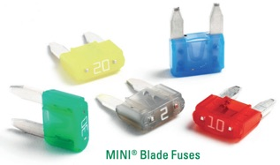
Wire Sizing
We use insulated copper wire (Cu). The insulation protects the wire and also protects the user. (R60)
Fusing:
All wire from battery to main breaker to PDP must have min #6 AWG wire
40 amp breakers must have min #12 AWG wire
30 amp breakers must have min #14 AWG wire
20 amp breakers must have min #18 AWG wire
The larger AWG number, the smaller diameter

Slide 7
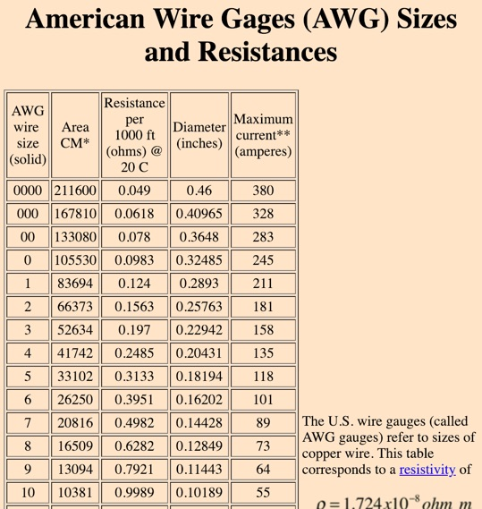
Neuron-sprints
http://hyperphysics.phy-astr.gsu.edu/hbase/Tables/wirega.html
What is my resistance of 10 feet of 12 AWG wire?
How much power loss (dissipated) at 40A?
What is my resistance of 10 feet of 26 AWG wire?
How much power loss (dissipated) at 40A?
Notes:
1.588 → 0.01588 ohms
25W
40.81→ 0.4081 ohms
652W

Slide 8
What did we learn?
The fuse upstream of the wire will protect the wire and components to the specified current rating.
When the copper wire gets too hot, it can damage the wire insulation.

Slide 9
Non-Signal Wire with constant polarity
Red, yellow, white, brown, or black-with-stripe on the positive (e.g. +24VDC, +12VDC, +5VDC, etc.) connections
Black or blue for the common or negative side (-) of the connections.

Slide 10
Signal Wire and Cables
Signal wires can be any color.
Do not use Red or Black. That is reserved for Power.
Signal Cables:
Can Bus
Ethernet
PWM

Slide 11
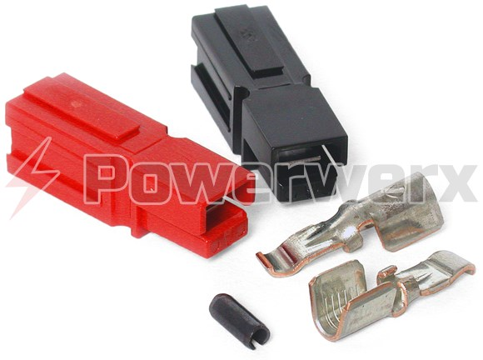
Connectors
We will use Anderson Powerpole Connectors as a standard connector.
40A fuse - 12 AWG - PP45
Label cable 40A max
30A fuse - 14 or 12 AWG - PP30
Label cable “30A max”
20A fuse - 18 AWG - PP15
Label cable “15A max”

Slide 12
Terminations
R45 - Each electrical terminal on the ROBOT battery, main breaker, and their connections (lugs, stripped wire ends, etc.) to the wire must be fully insulated at all times.
R49 - All electrical components shall be electrically isolated from frame.

Slide 13
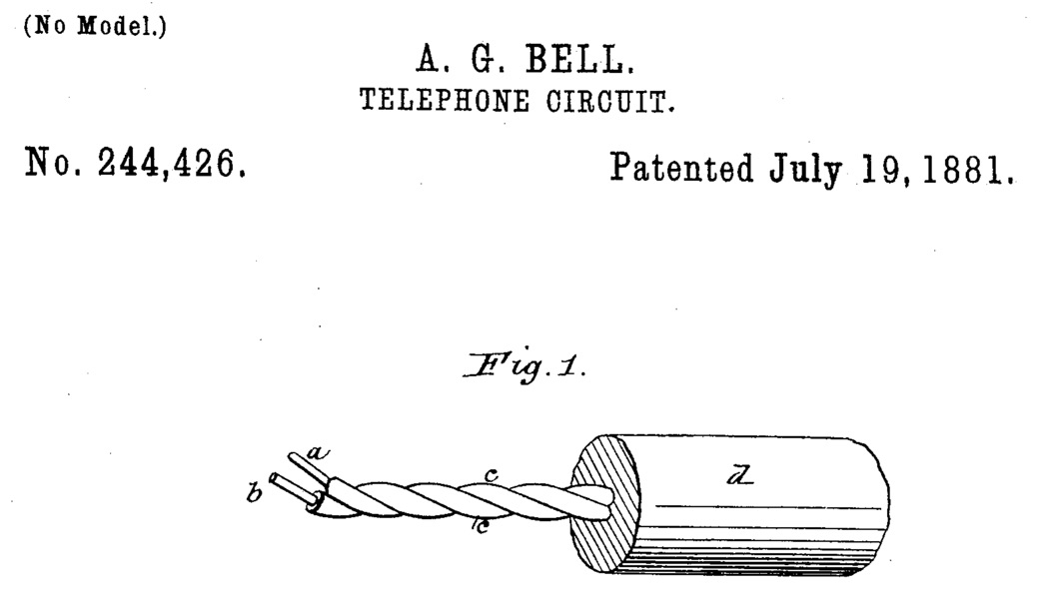
Best Practices
Develop a harness diagram that shows wire routing
Separate wires by type to reduce “cross talk” - Power and Signal.
Wires of different types should not run parallel to each other
If they cross, they should be placed perpendicular to each other
Run twisted pairs
Secure wire in such a way that prevents mechanical impact of any kind from pulling wires
Check all wire crimps for a good connection / Insulate all connectors
Allow slack in wire to replace control component
Cables should be routed so they can be replaced/repaired.
Battery cables short as possible to PDP / Place motor controllers close to the PDP
Label all cables on each end
NEATNESS COUNTS – tie up cable runs and tie wrap spooled excess wires/cables

Slide 14
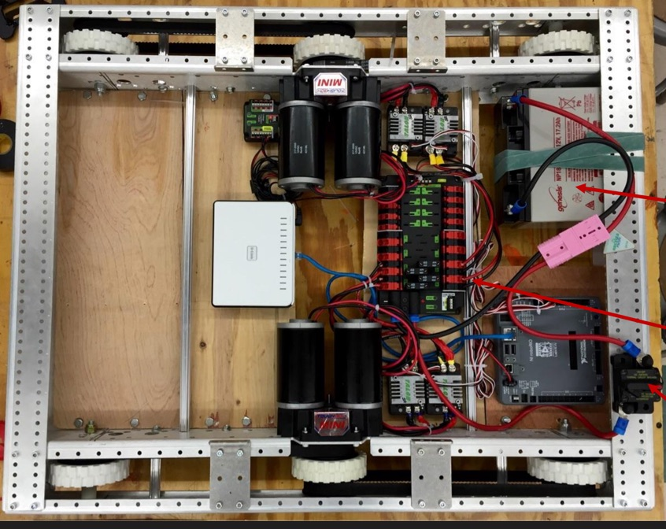
Observations?

Slide 15
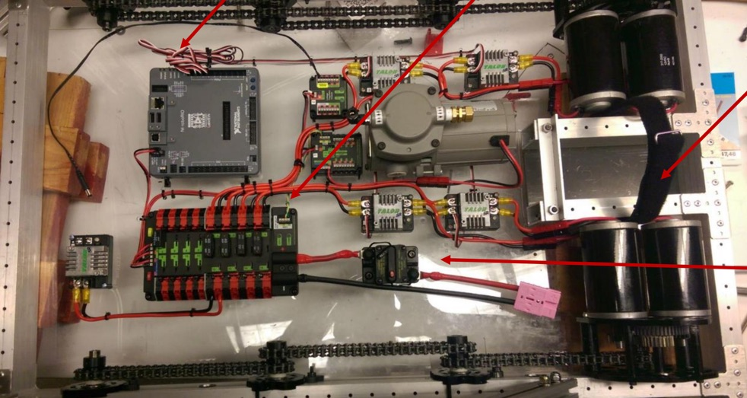
Observations?

Slide 16
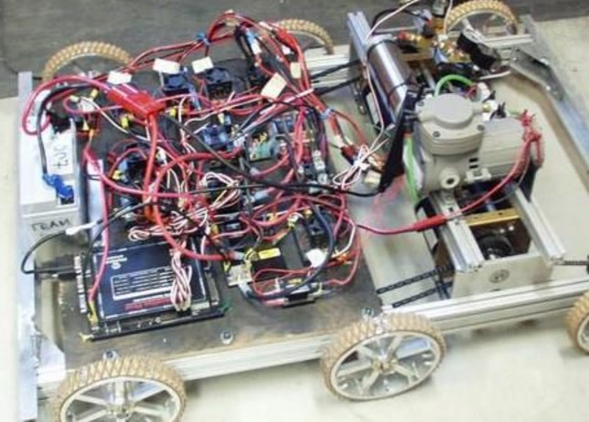
Observations?

Slide 17
Other sources
FRC 2228 - CougarTech (slide 4, 5) http://hflrobotics.com/resources/Training/2-Components%20and%20FIRST%20System%20Structure/CTElect2-Electrical%20Design-Layout-Wiring.pdf
FRC 1678 - Citrus Circuits (slide 4, 6, 12, 13, 14)
http://www.citruscircuits.org/uploads/6/9/3/4/6934550/robot_wiring.pdf
FTC Robot Wiring Guide (good general guide)
https://www.firstinspires.org/sites/default/files/uploads/resource_library/ftc/robot-wiring-guide.pdf

Slide 18
Other sources
FRC 254 - The Cheesy Poofs (Start at beginning of season) https://www.team254.com/category/frc/2018-frc-build-season-frc/

